Slide 1
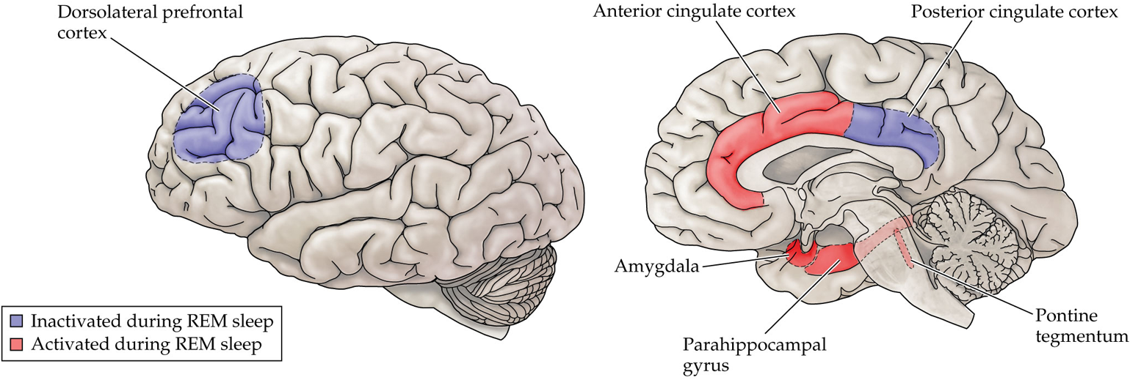
Brain activity Changes during REM/Dreaming
May help explain unique qualities of dreams during REM

Slide 2
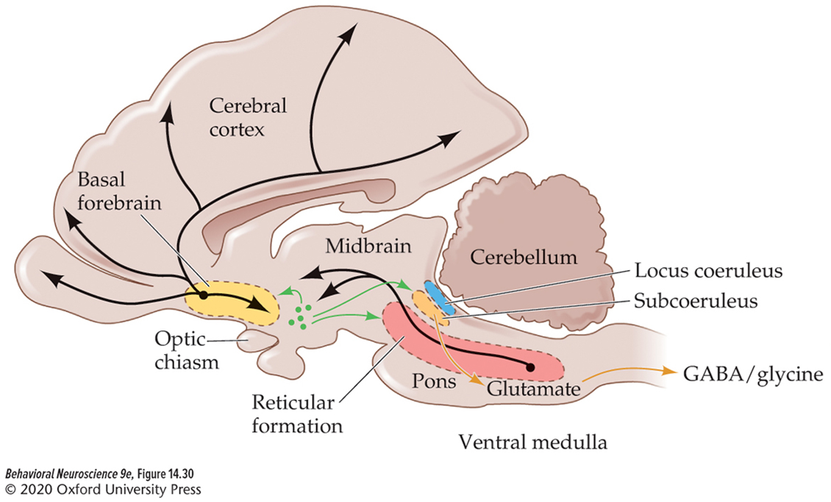
Sleep/wake Circuitry:
Brainstem structures regulate arousal and REM sleep
The reticular formation regulates arousal/wakefulness.
  Electrical stimulation excites cortex and wakes animals up from sleep.
  Damage results in persistent sleep.
The Subcoeruleus regulates REM sleep.
  Stimulation induces and prolongs REM sleep.
  Damage abolishes REM sleep.
  Inhibits motor neurons of the body.
  Sends info to the superior colliculus for saccadic eye movements.

Slide 3
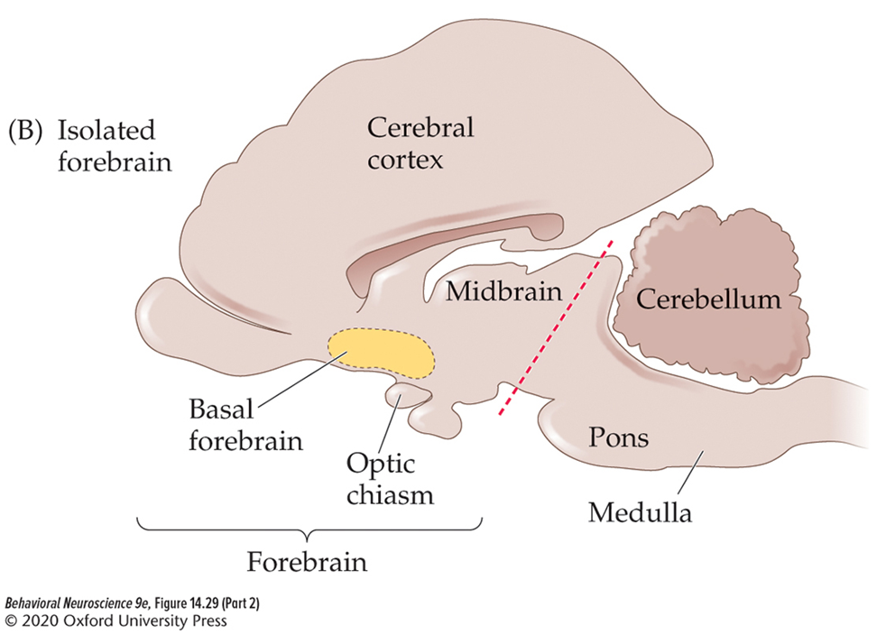
Sleep/wake Circuitry:
The forebrain supports N3 sleep
Electrical stimulation of the basal forebrain can induce slow wave activity (delta waves).
  Basal forebrain regulates activity of GABA.
Lesions of the basal forebrain result in insomnia.

Slide 4
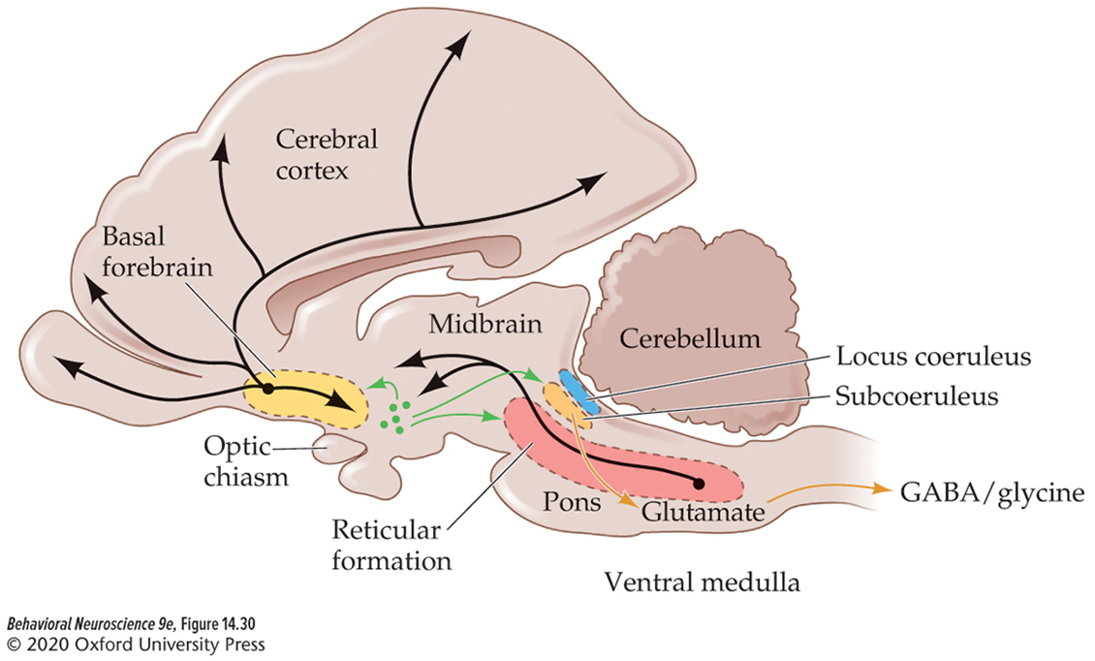
Sleep/wake Circuitry:
The Hypothalamus Acts like a switch board between sleep and wakefulness
The Neuropeptide hypocretin is important for sleep/wake transitions.
  Almost exclusively found in the hypothalamus.
  Axons project to the basal forebrain, reticular formation, and subcoeruleus!

Slide 5

Narcolepsy
A neurological disorder that affects the brain's ability to control sleep-wake cycles.
Symptoms:
  Excessive daytime sleepiness
  Cataplexy
  Sleep paralysis
  Insomnia
  comorbid REM sleep behavior disorder
The main causal factor is loss of hypocretin neurons in the hypothalamus.
  May be linked to autoimmune disease

Slide 6
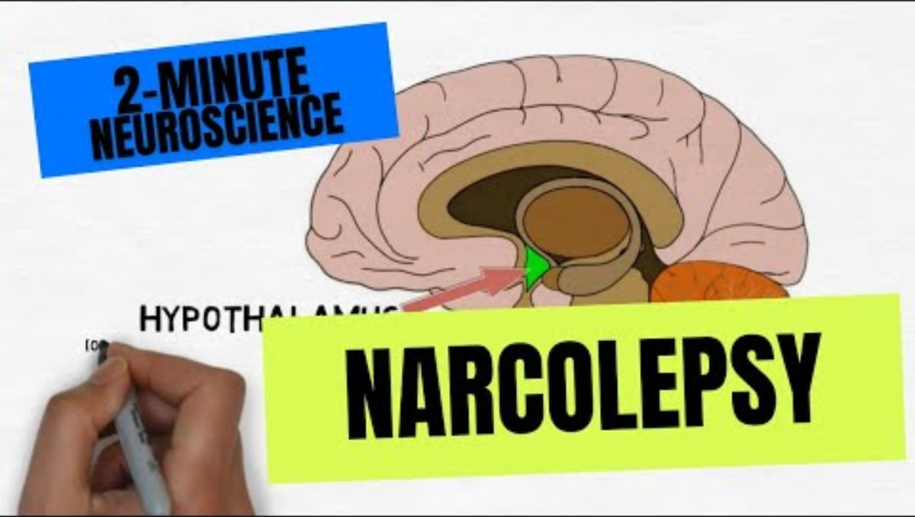
Two-minute neuroscience: Narcolepsy
Notes:
https://www.youtube.com/watch?v=DJU0CyDCETI

Slide 7
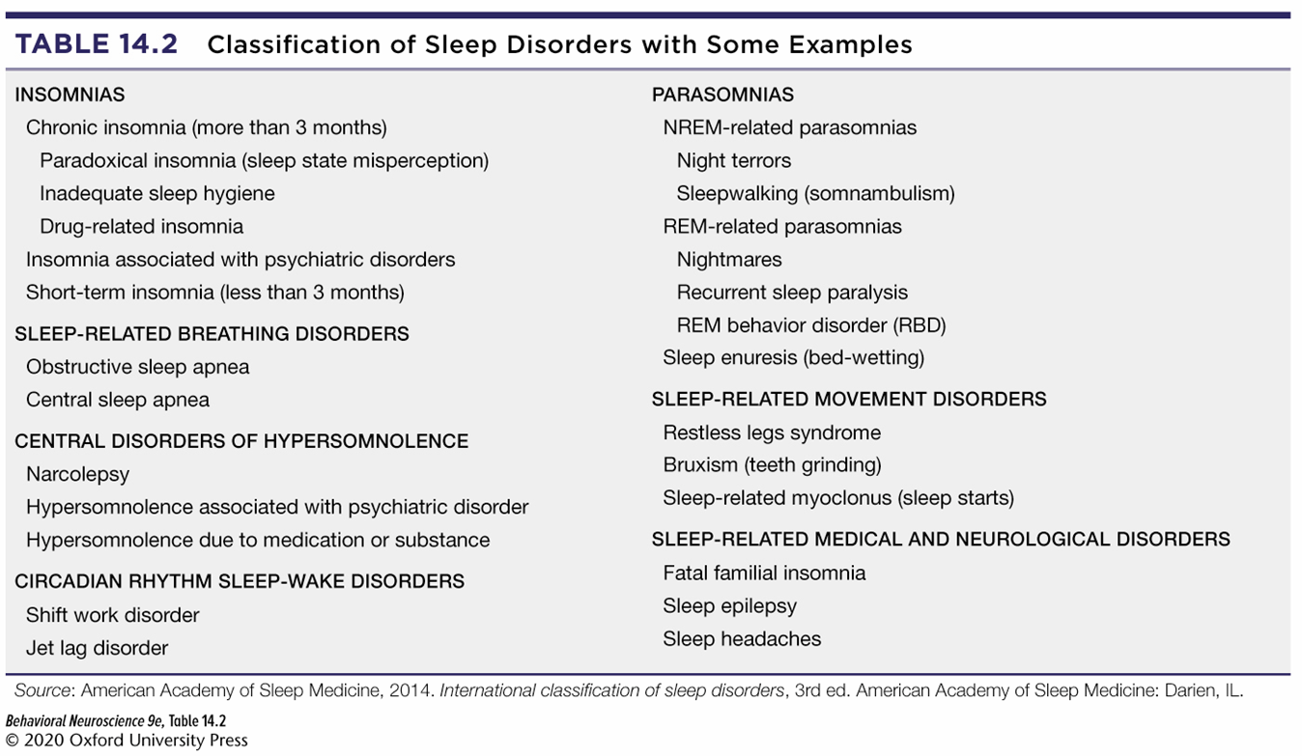
There are many different sleep disorders that can have negative biological and cognitive consequences

Slide 8

Sleep deprivation/Poor quality sleep can have detrimental effects
Effects of sleep deprivation:
  Increased irritability/mood swings
  Impaired cognitive abilities and memory
  Episodes of disorientation
  Occasionally hallucinations
  Severe sleep deprivation can kill an organism!

Slide 9


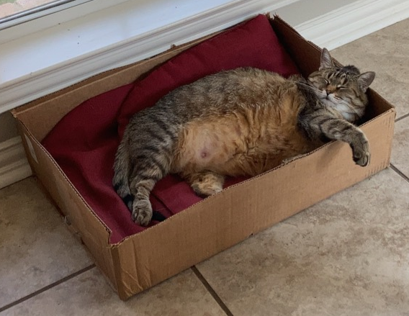
Sleep may offer evolutionary advantages
Conservation of energy
Niche adaptation
Body restoration
Memory consolidation

Slide 10
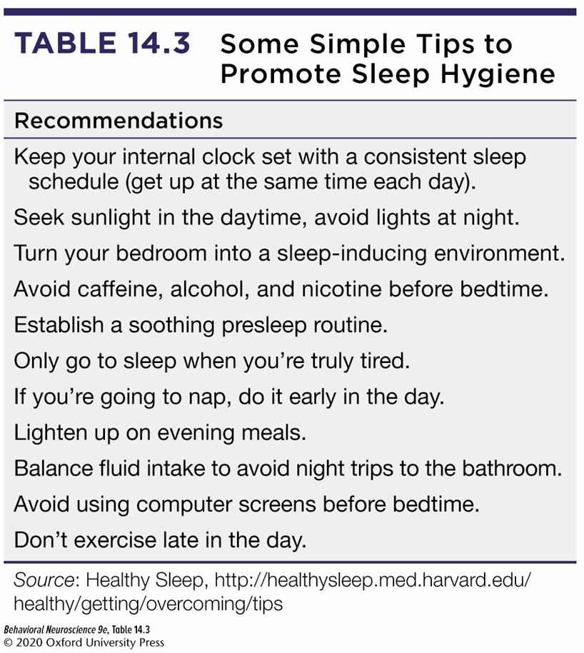

Slide 11
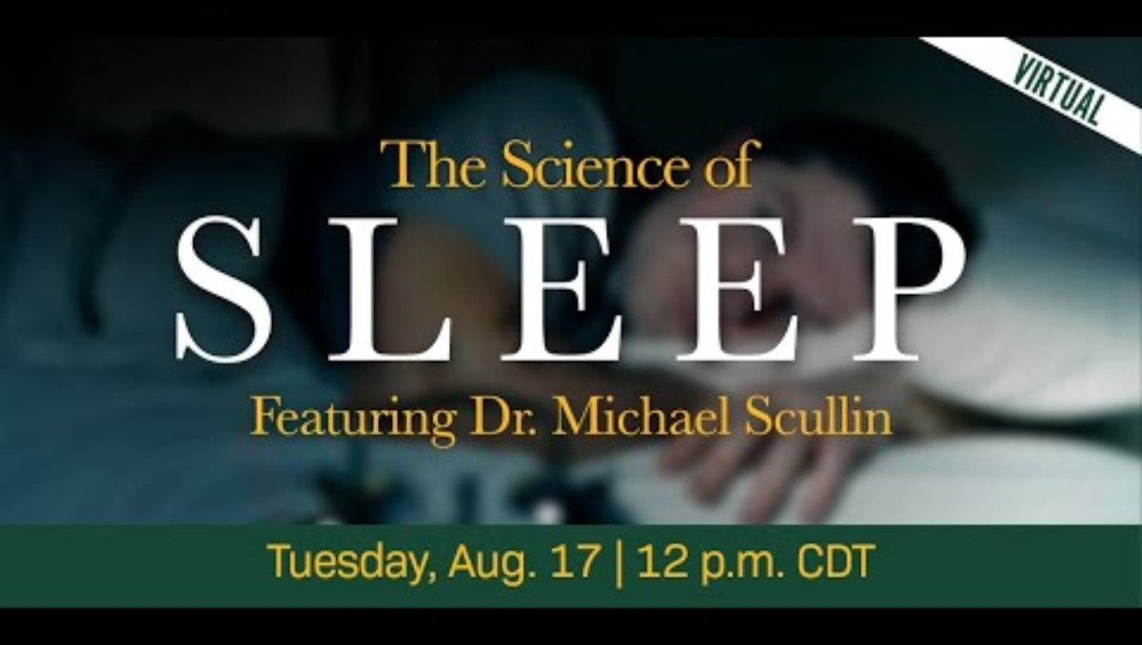
Dr. Scullin and the Neuroscience of Sleep

Slide 12

Matthew walker’s Ted Talk about sleep
https://www.youtube.com/watch?v=5MuIMqhT8DM

Slide 13
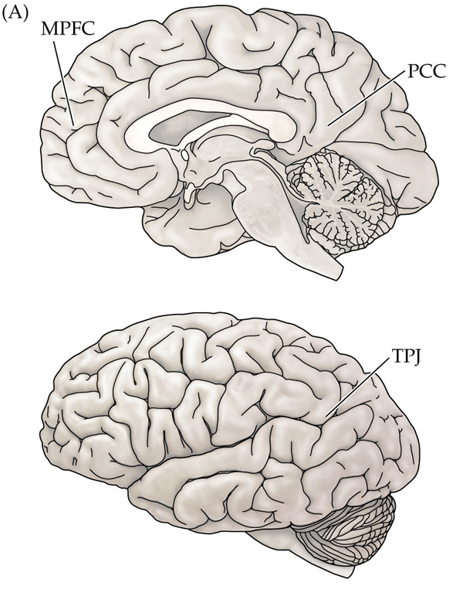
What Does the Brain do while awake but not engaged in a task?
The default-mode network is a collection of brain regions whose activity increases while awake but not engaged in a task.
  medial prefrontal cortex
  posterior cingulate cortex
  temporoparietal junction
Decreased activity during cognitive tasks.
May reflect inward focus of attention
Dysfunction linked to impaired cognition in different psychological disorders.

